Slide 1
Geography Olympiad of Central, South and South Eastern Europe
MULTIMEDIA TEST
Belgrade, 2019

Slide 2
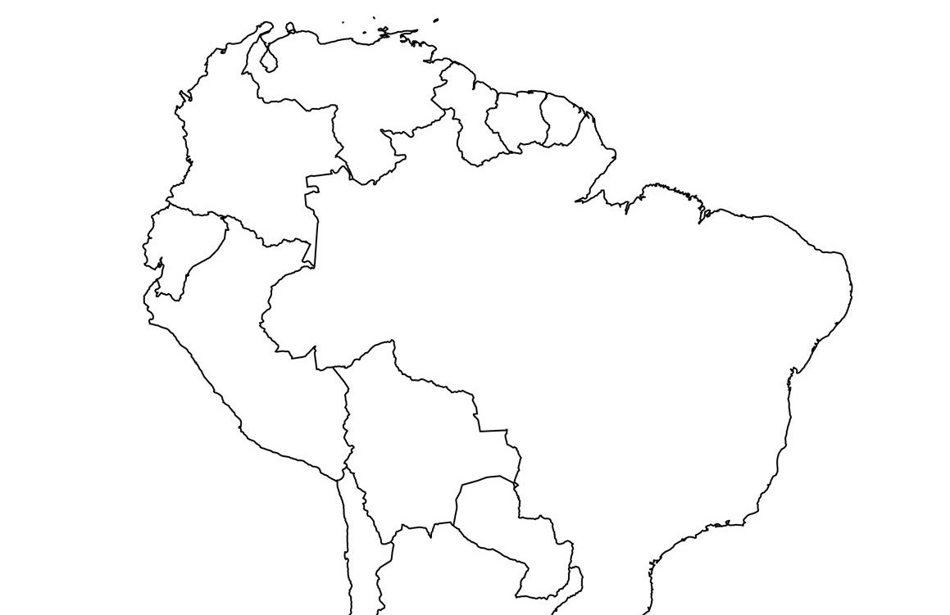
1) Circle the letter which matches the order of languages on the map:
1 ENGLISH - 2 FRENCH - 3 DUTCH
1 DUTCH – 2 ENGLISH – 3 FRENCH
1 FRENCH – 2 DUTCH – 3 ENGLISH
D) 1 ENGLISH – 2 DUTCH – 3 FRENCH
1
2
3

Slide 3
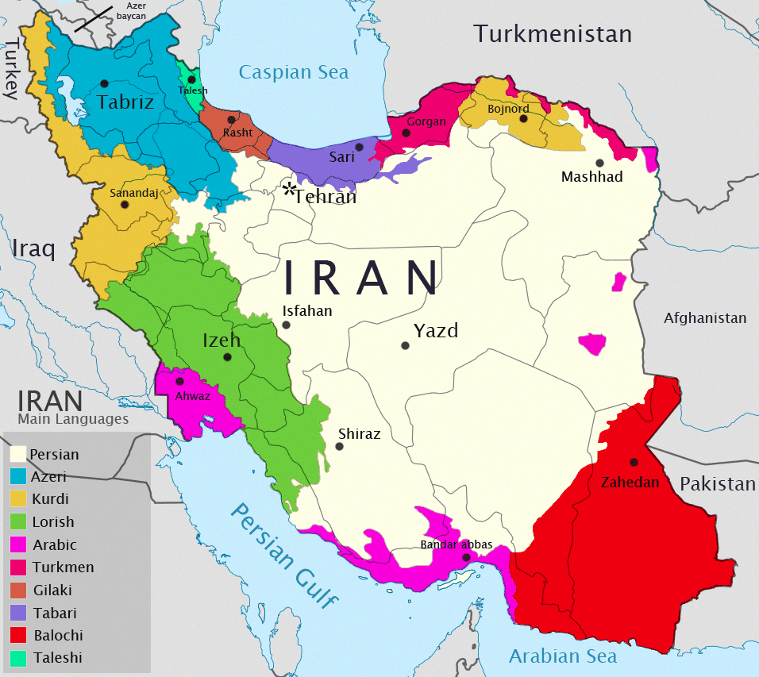
2) On the ethnic map of Iran, blue color represents which one of the following nations:
KURDS
B) AZERBAIJANIS
C) RUSSIANS
D) TURKS

Slide 4
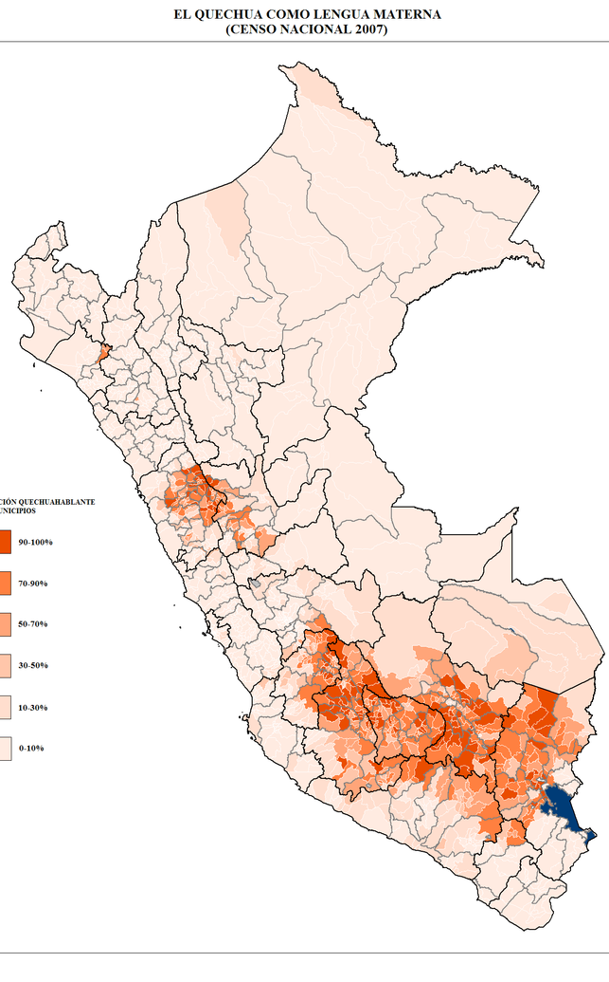
3) The map of Peru shows the territorial distribution of one indigenous language:
QUECHUA
AYMARA
GUARANI
TUPI

Slide 5
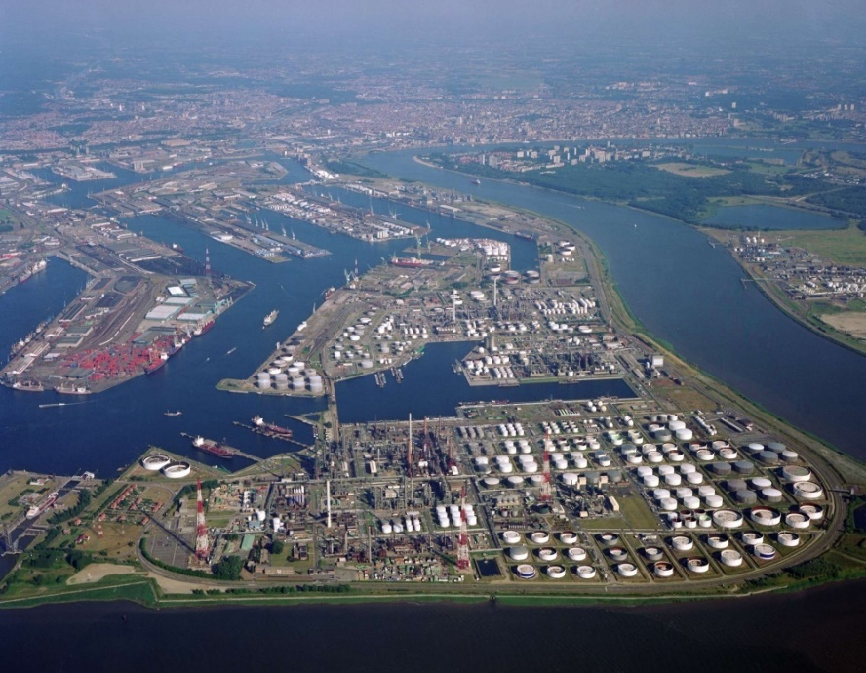
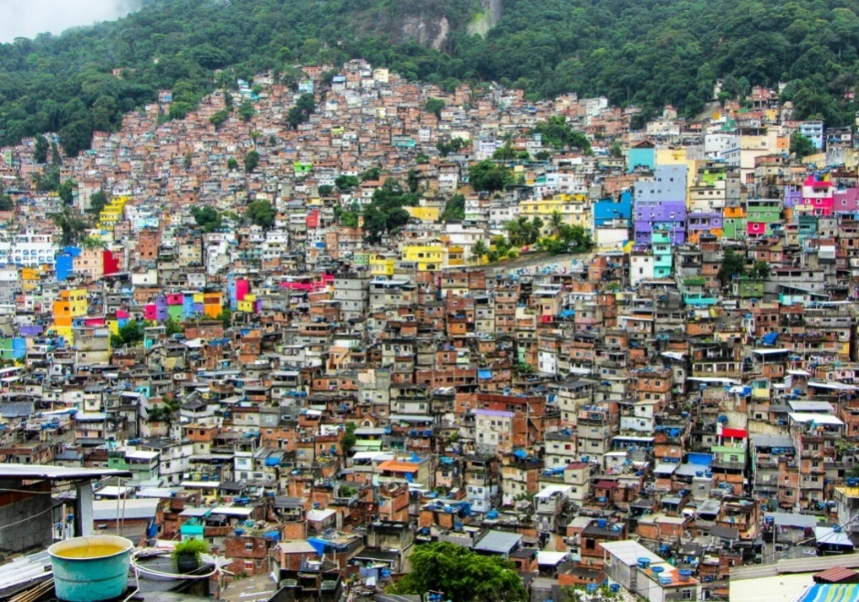
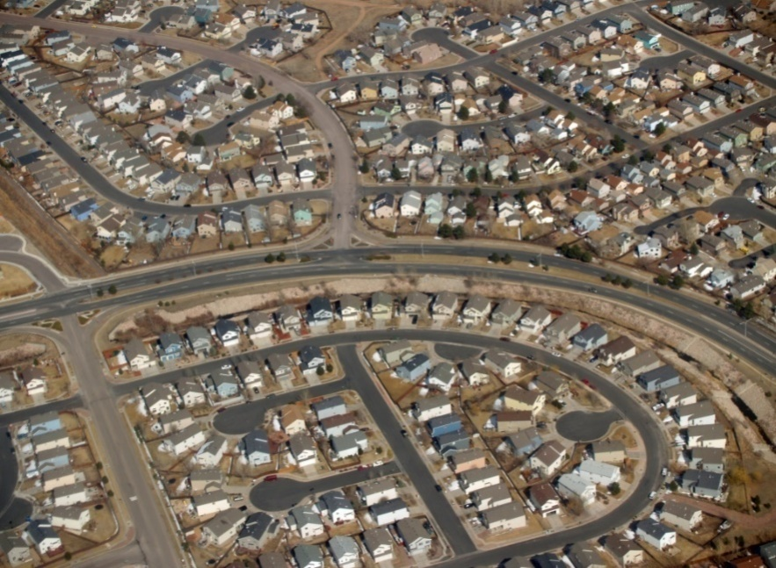
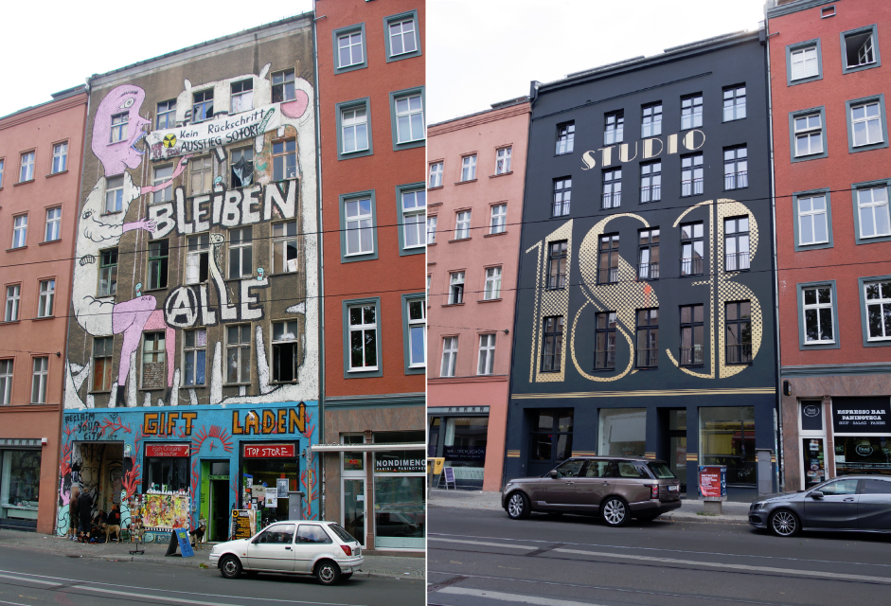
4) Which one of the following pictures shows gentrification?
A
B
C
D

Slide 6
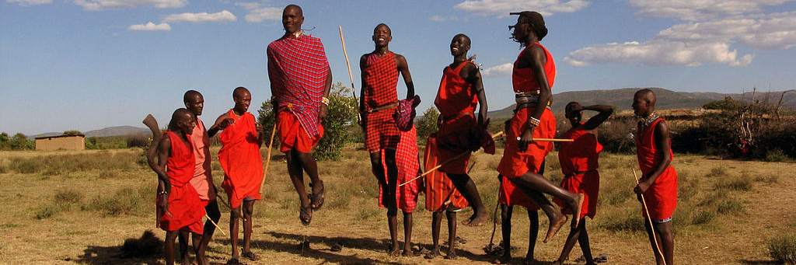






5) The people in the picture are performing their traditional dance. They belong to the Nilotic ethnic group, and they are mostly settled in which of the two following countries:
A)
B)
C)
D)

Slide 7
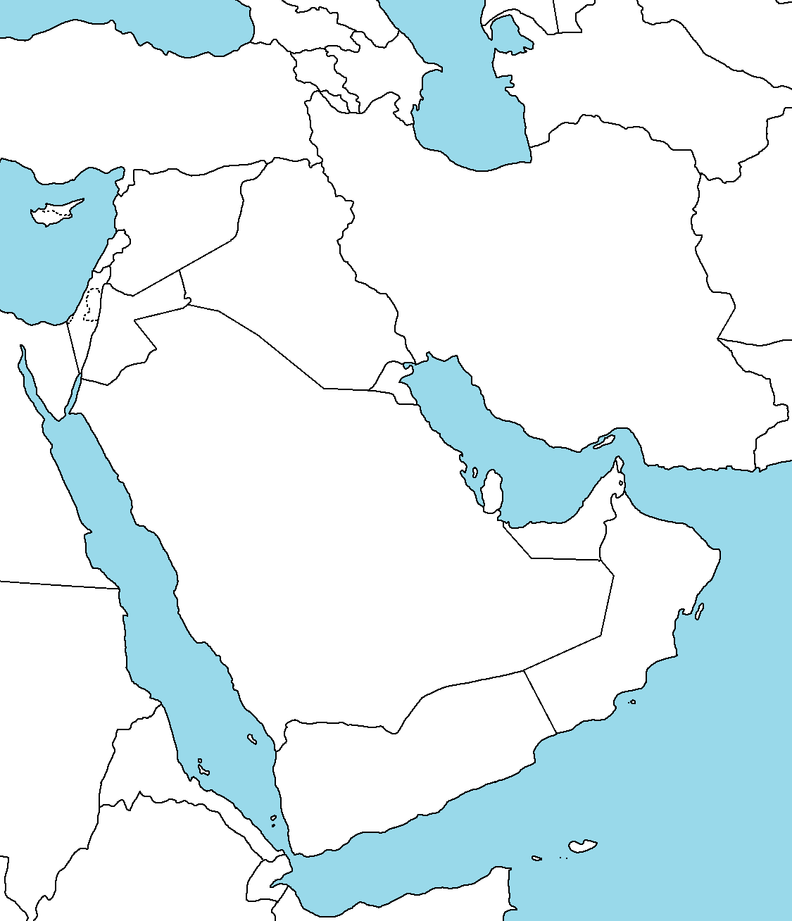
6) The numbers on the map of southwest Asia represent:
A)THE NUMBER OF CHRISTIANS (IN THOUSANDS)
B) THE NUMBER OF SYRIAN REFUGEES (IN THOUSANDS)
15
15
75
75
75
75
70
70
70
70
27
27
27
27
32
10
32
32
32
10
90
90
90
90
C) THE PERCENTAGE OF SHII ISLAM MEMBERS IN RELIGION STRUCTURE
D) THE PERCENTAGE OF SUNNI ISLAM MEMBERS IN RELIGION STRUCTURE
30
30
80
80
85
80
85
25
25
56
56

Slide 8
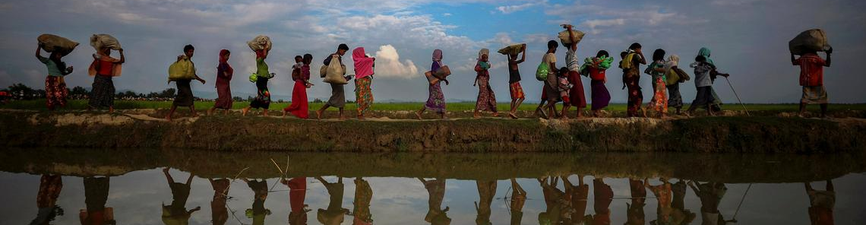
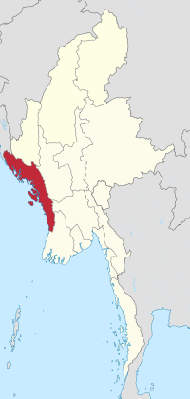
7) The picture above shows Rohingya
people escaping from their homeland (the red region of one state in southeast Asia – map left). In 2017 and 2018 over 700.000 Rohingya refugees escaped to the state with:
MUSLIM MAJORITY B)HINDU MAJORITY
C) BUDDHIST MAJORITY D)CHRISTIAN MAJORITY

Slide 9
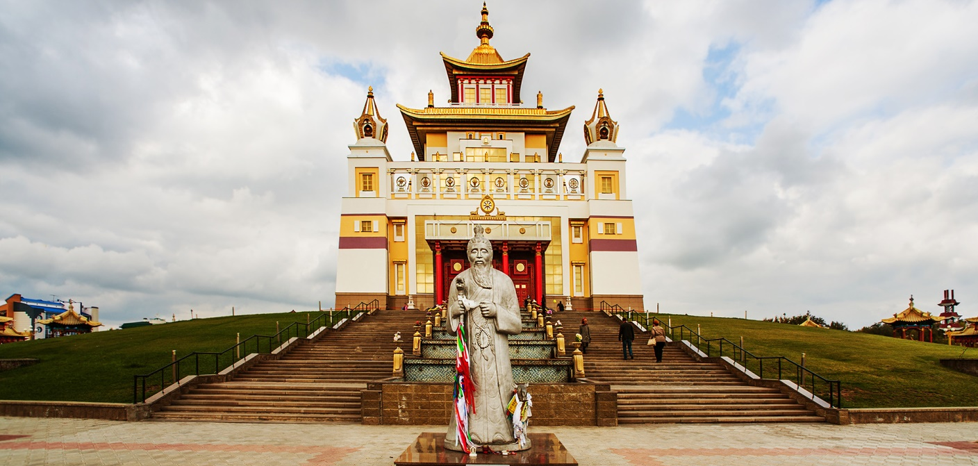
8) Only one ethnic group in Europe follows the religion in the picture above. This nation is settled in one of the Russian federal republics:
A) KALMYKIA B) DAGESTAN
C) ALTAI D) TATARSTAN

Slide 10
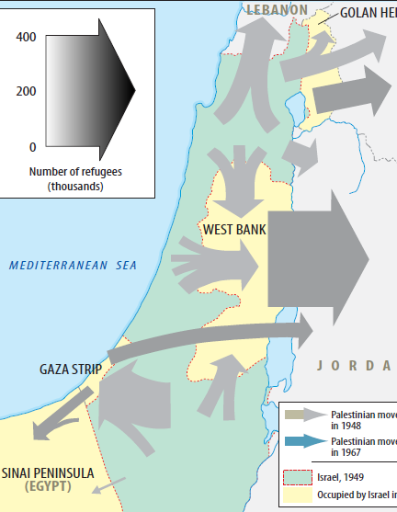
9) The grey arrows on the map show:
A) SYRIAN REFUGEES’ MOVEMENTS IN 2016
B) WIND DIRECTIONS
C) PALESTINIAN REFUGEES’ MOVEMENTS AFTER THE WARS IN 1948 AND 1967
D) JEWISH REFUGEES’ MOVEMENTS AFTER THE WARS IN 1948 AND 1967

Slide 11
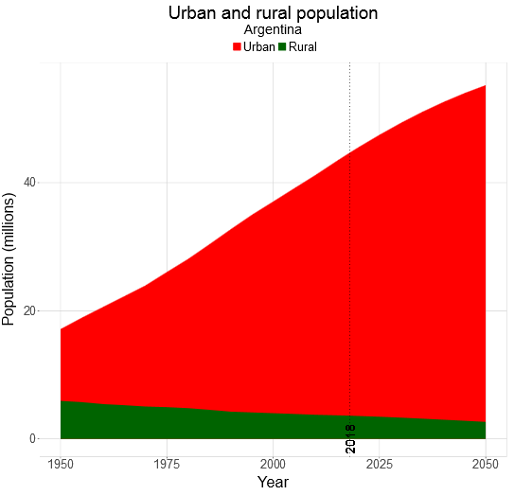
10) The diagram shows the relation
of urban and rural population in:
AUSTRALIA
B) AFGHANISTAN
C) ARGENTINA
D) ALGERIA

Slide 12
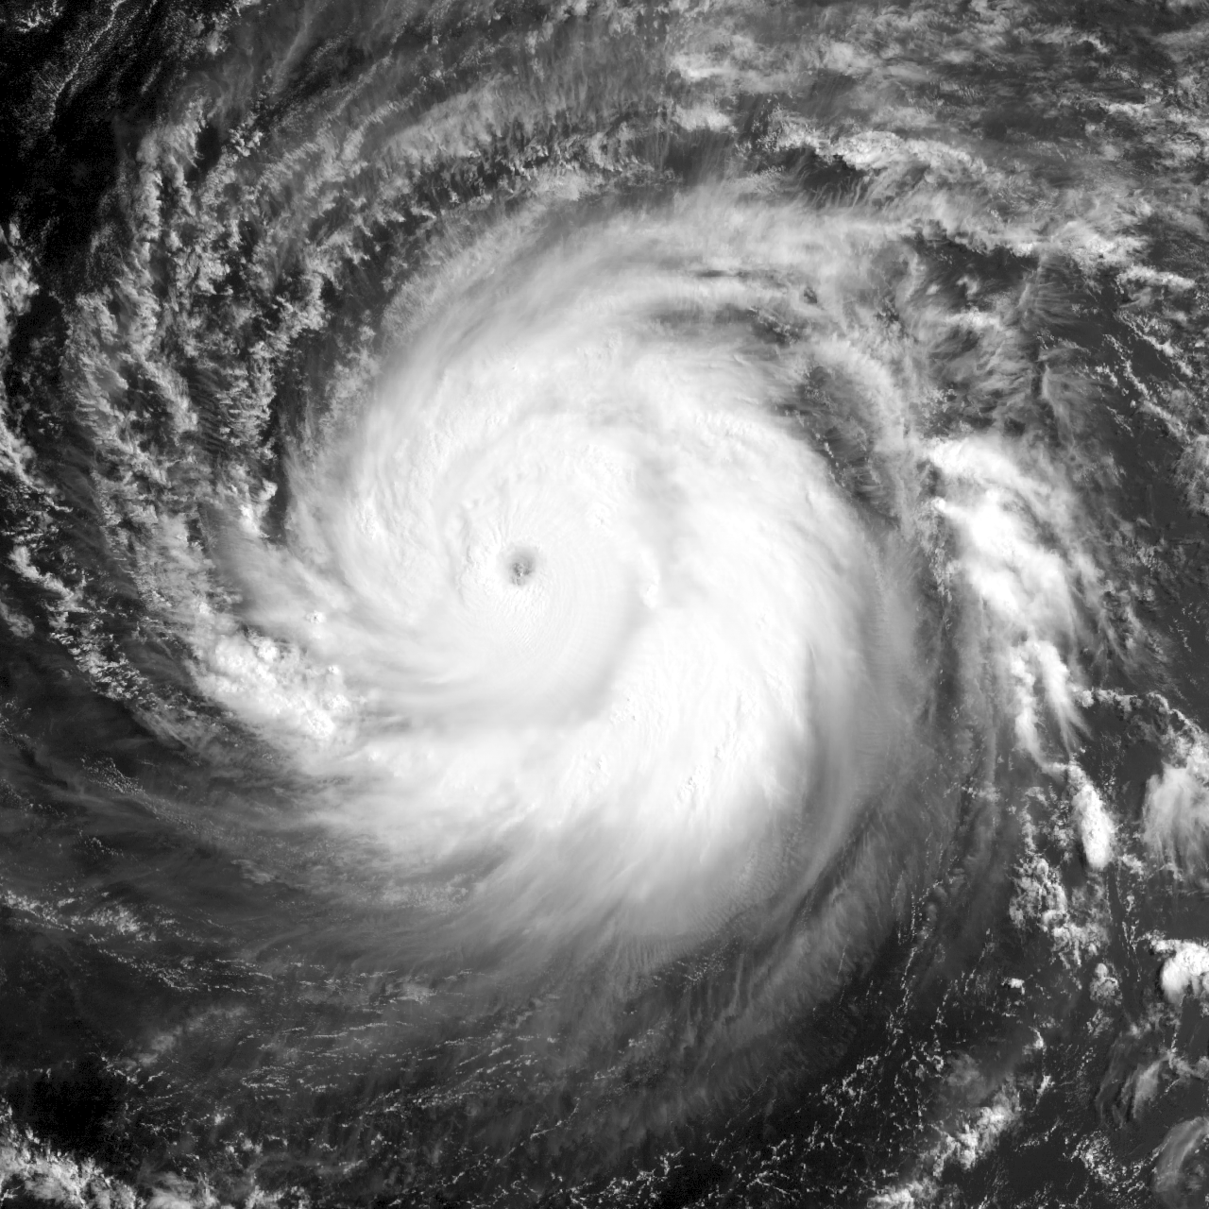
11) This hurricane is captured:
A) AT THE WEST COAST OF AUSTRALIA
B) ABOVE THE EQUATOR
C) IN THE SOUTHERN
HEMISPHERE
D) IN THE NORTHERN
HEMISPHERE

Slide 13




12) Of the following flags, which belongs to an African country?
A
B
C
D

Slide 14
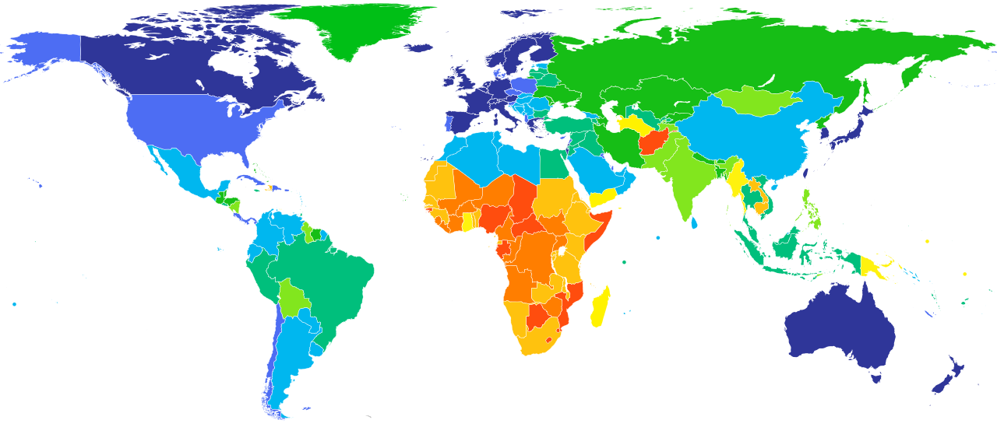
13) The map shows states according to:
A) LIFE EXPECTANCY B) NUMBER OF TOURISTS
C) GDP PER CAPITA D) AIR POLLUTION
Max.
Min.

Slide 15
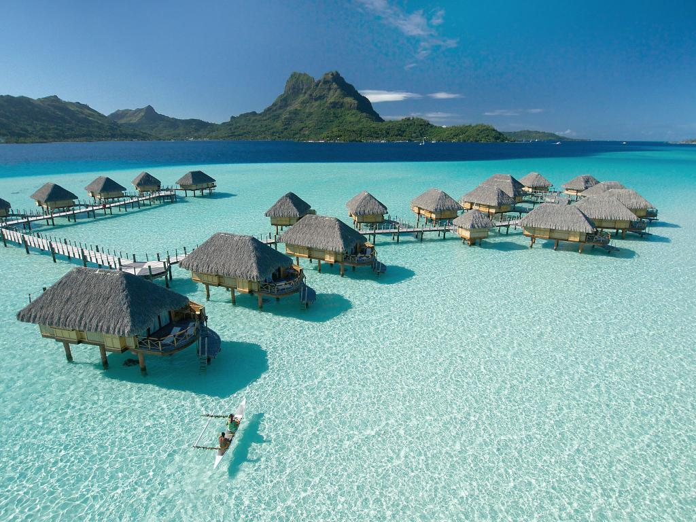
14) This kind of landscape cannot be seen in:
A) INDONESIA
B) MALDIVES
C) FRENCH
POLYNESIA
D) SEYCHELLES

Slide 16
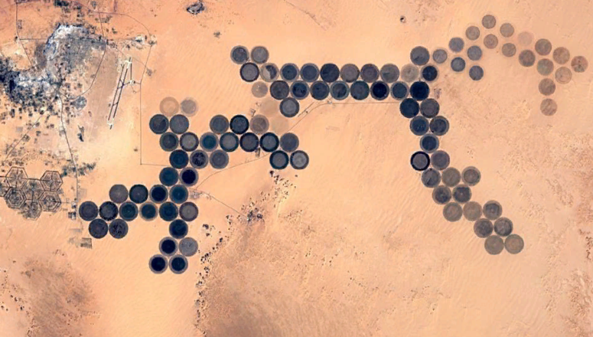
15) The satellite image above Lybia (Sahara area) shows:
PETROLEUM FIELDS
B) WASTEWATER
COLLECTORS
C) MILITARY AREA
D) ARABLE LAND

Slide 17
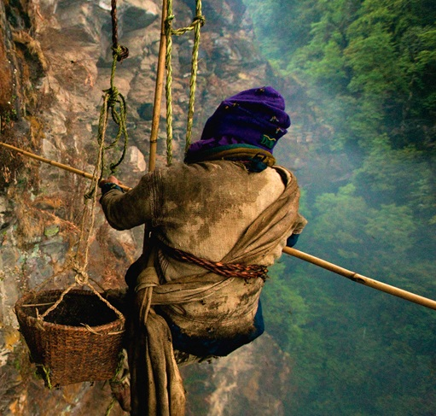
16) This man in Nepal is risking his life while searching for:
A) HONEY
B) BIRDS
C) BATS
D) JEWELRY

Slide 18
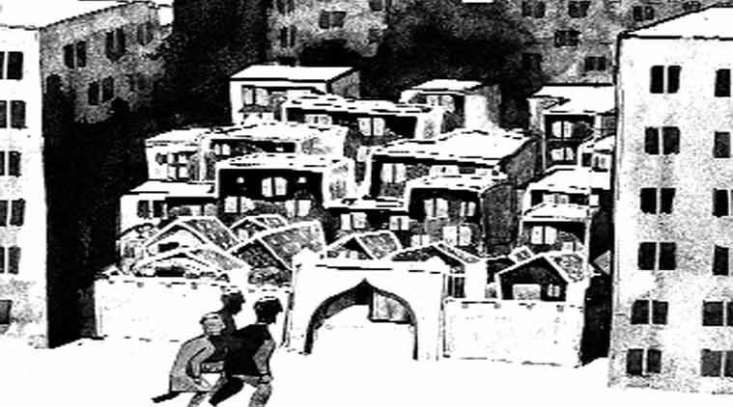
17) This caricature shows:
GENTRIFICATION B) GHETTOIZATION
C) SUBURBANIZATION D) CENTRALIZATION

Slide 19
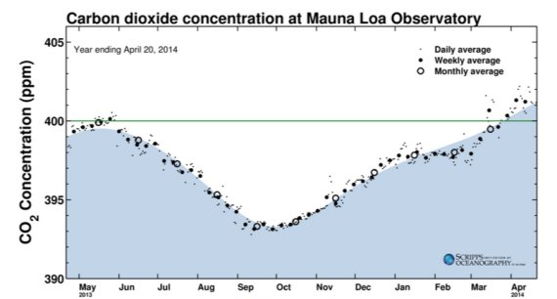
18) The concentration of carbon dioxide at Mauna Loa observatory is the lowest in October due to:
VOLCANO INACTIVITY
B) UNUSUAL HIGH TEMPERATURE OF THE OCEAN
C) THE END OF VEGETATION PERIOD IN NORTH HEMISPHERE
D) UNUSUAL LOW TEMPERATURE OF THE OCEAN

Slide 20
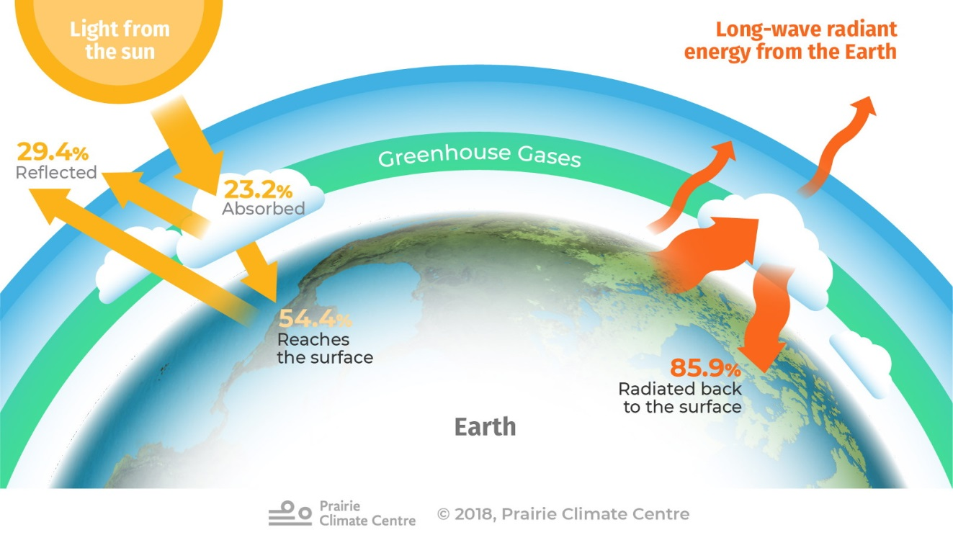
19) Which part of the light does CO2 absorb most?
A) VISIBLE B) ULTRAVIOLET
C) INFRARED D) X-RAYS

Slide 21
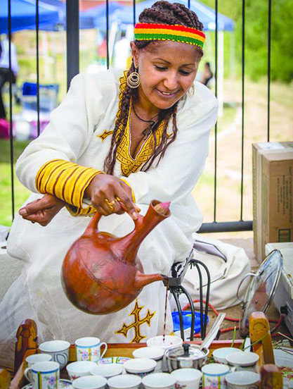
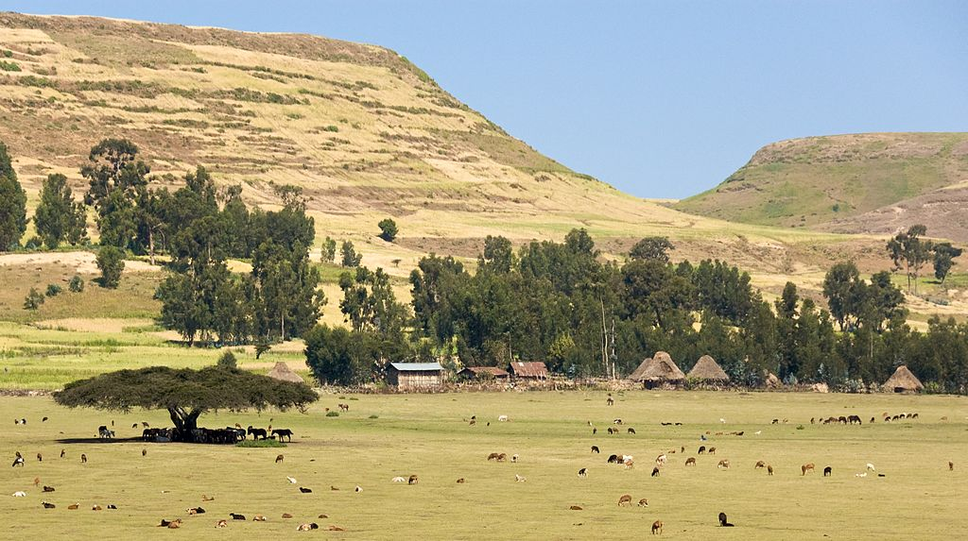
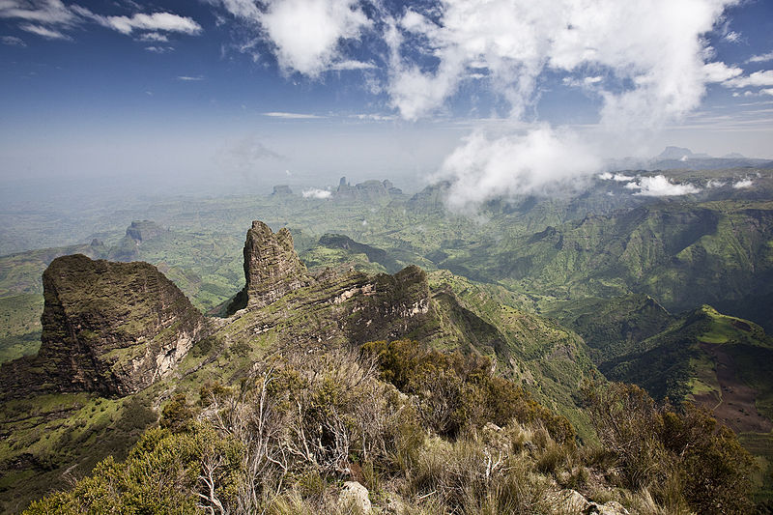
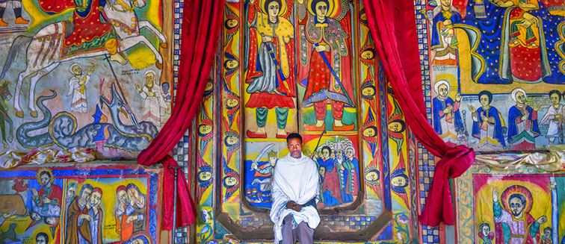
20) Next photos were captured in:
A) GHANA
B) MOROCCO
C) CONGO
D) ETHIOPIA

Slide 22
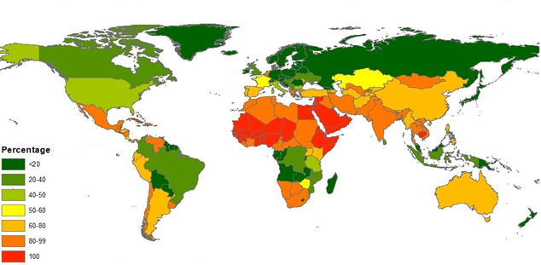
21) The map represents the percentage of:
A) POPULATION UNDER SEVERE WATER SCARCITY AT LEAST ONE MONTH IN YEAR
B) PERCENTAGE OF FOREST AREA
C) PERCENTAGE OF DESERT AREA
D) PERCENTAGE OF THE POPULATION UNDER 15 YEARS OLD

Slide 23
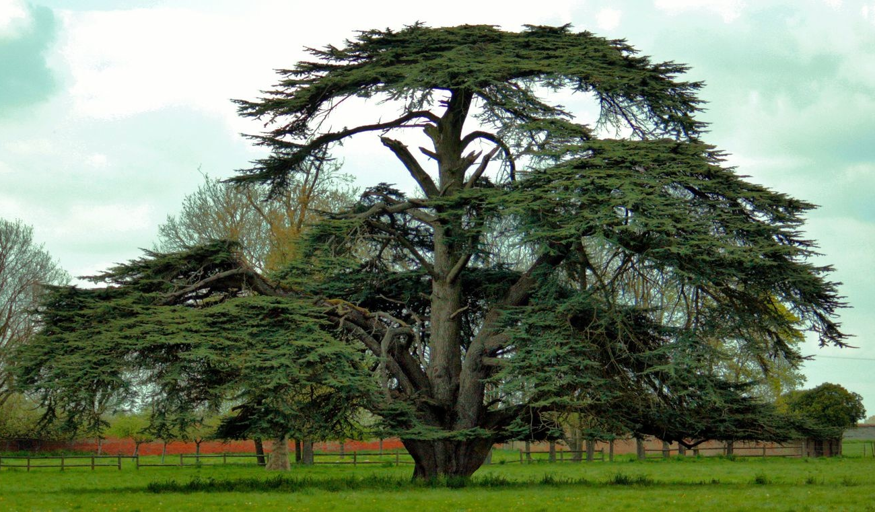
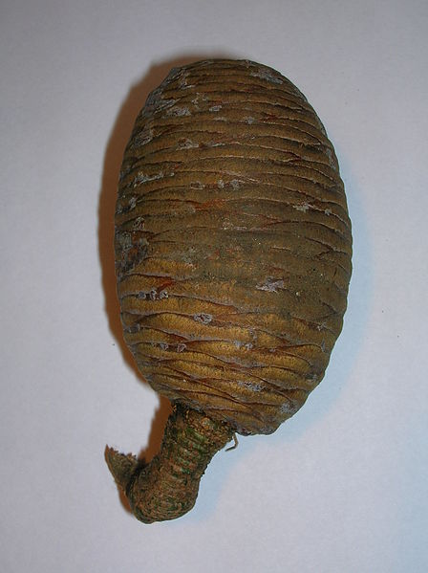
22) The tree in the pictures is a national symbol of:
A) JORDAN B) LEBANON
C) CANADA D) TURKMENISTAN

Slide 24
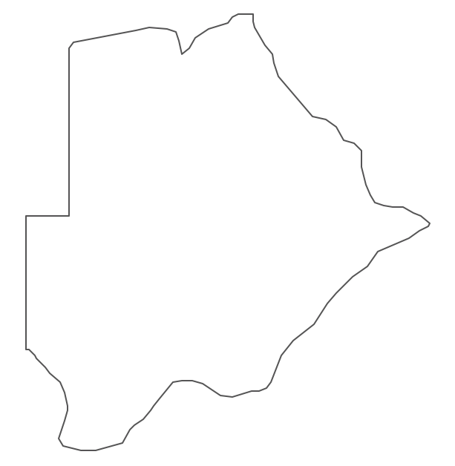
23) This map is a contour of:
ZAMBIA
ZIMBABWE
BOTSWANA
RWANDA

Slide 25
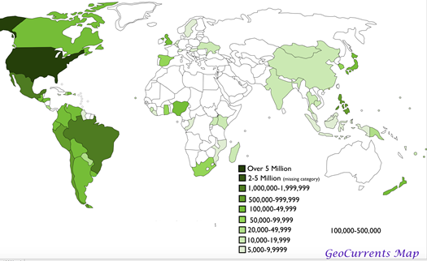
24) The map of the world shows the population of:
A) PROTESTANT B) CATOLIC
C) MORMONS D) BUDDHISTS

Slide 26
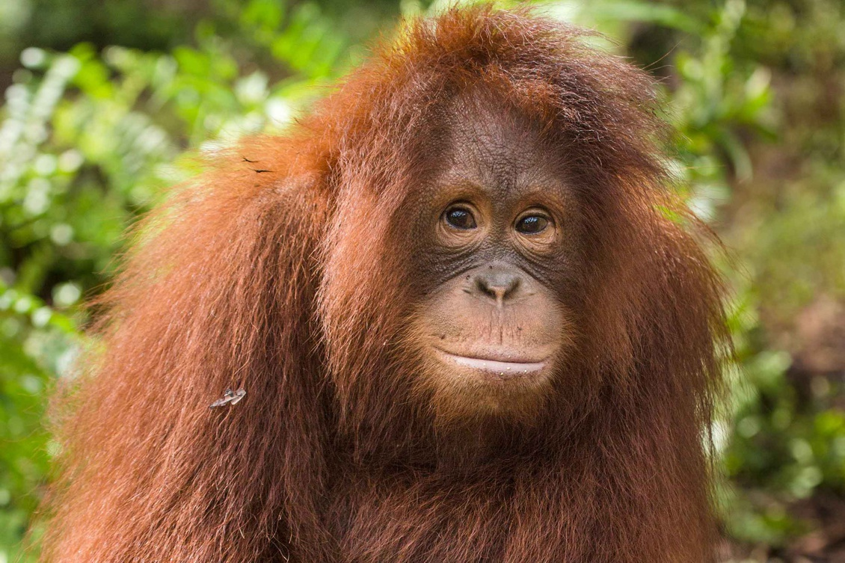
25) This animal is endangered due to:
EXPLOITATION OF BANANAS
SOIL EROSION
LACK OF THE FRESH WATER
SPREADING OF PALM OIL PLANTATIONS

Slide 27
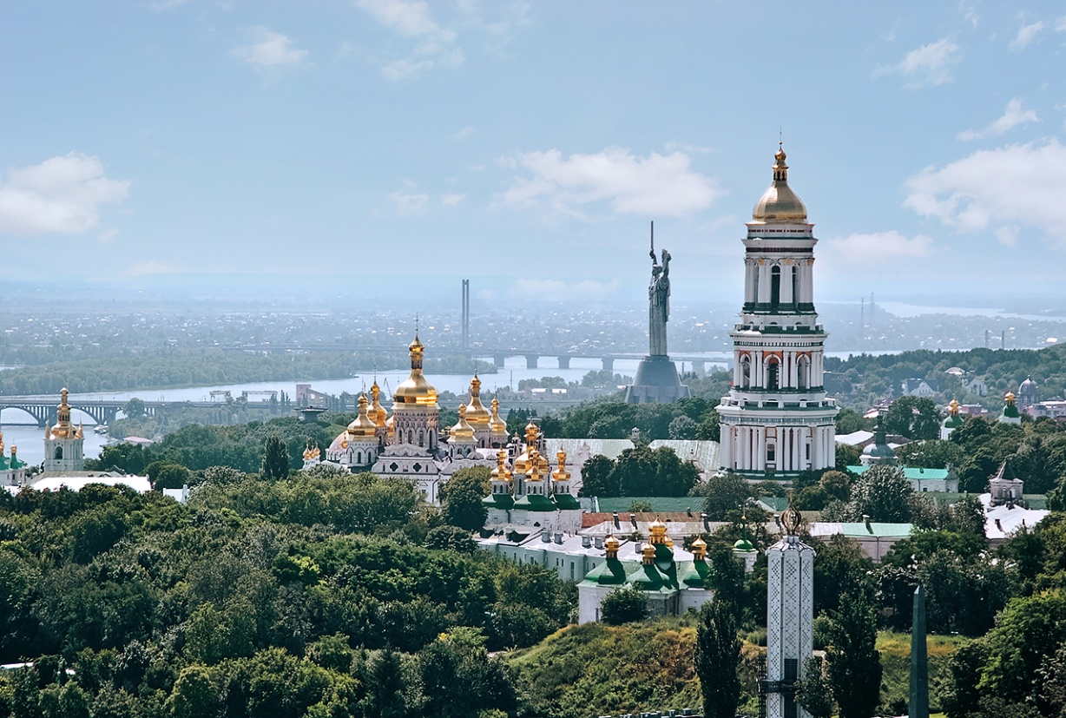
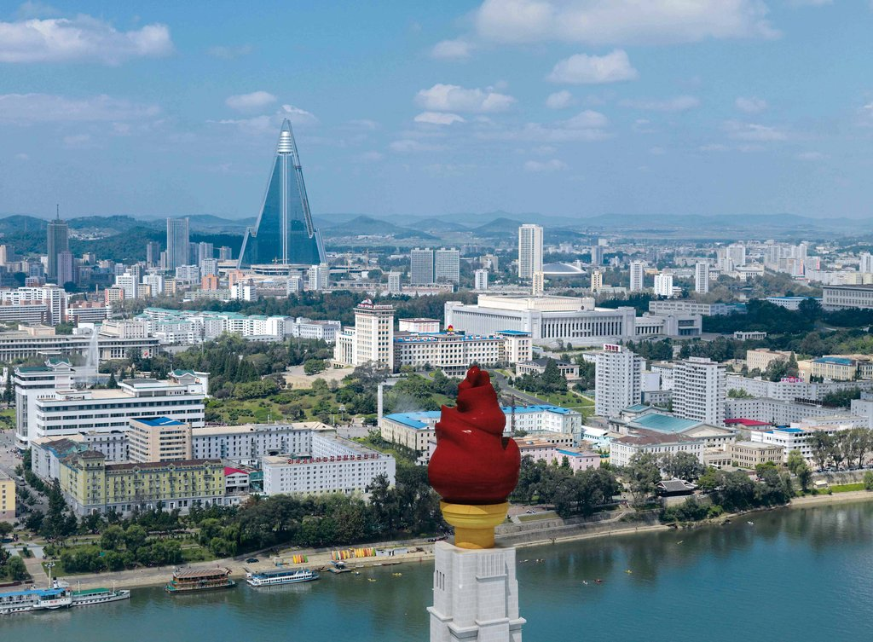
26) What is the minimum
number of states you
need to go through, in
order to get from city A
to city B?
A) ONE
B) TWO
C) THREE
D) FOUR
A
B

Slide 28
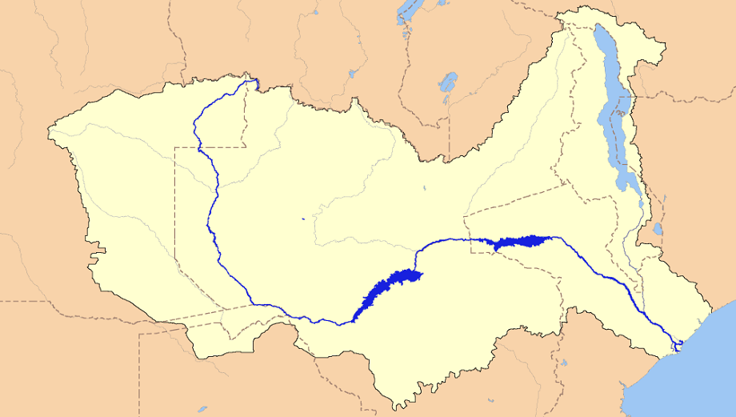
27) The map shows the basin of an Africa river?
A) ORANGE B) CONGO
C) ZAMBEZI D) LIMPOPO

Slide 29
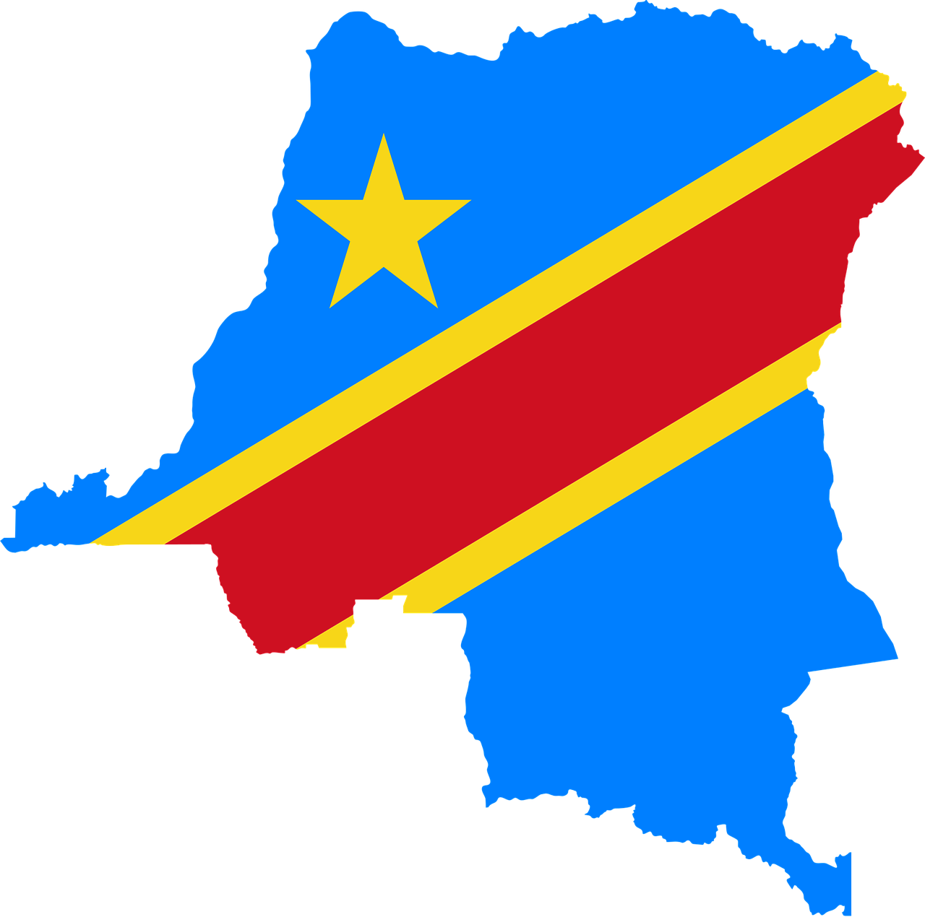
28) This African country was colonized by:
A) PORTUGAL
B) ENGLAND
C) FRANCE
D) BELGIUM

Slide 30
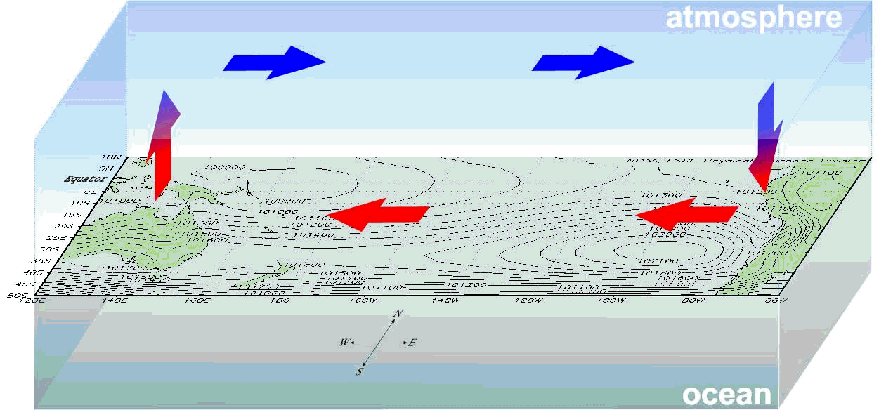
29) What is the name of the shown weather event?
A)LA NINA B)CYCLONE C)TSUNAMI D)EL NINO

Slide 31
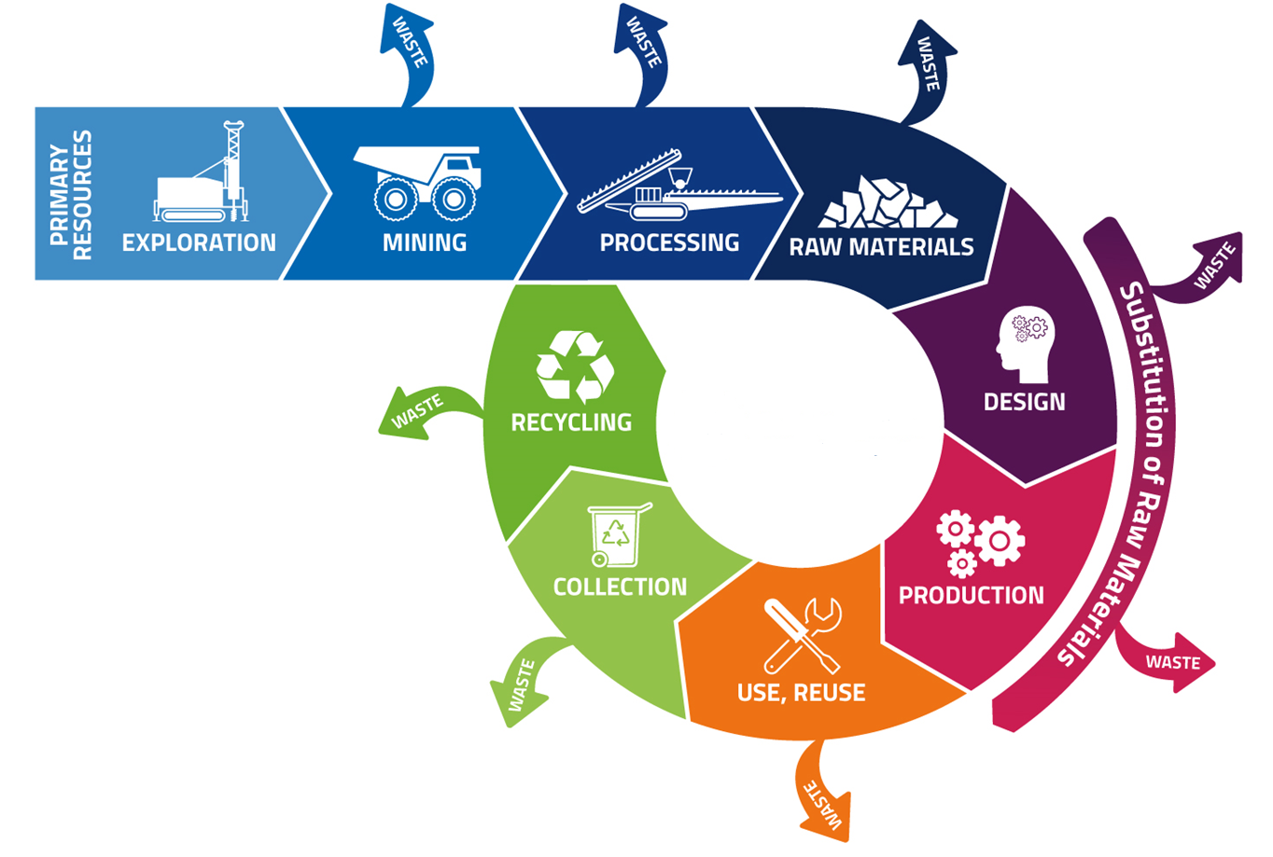
30) What does the diagram represent?
A) INDUSTRIAL SYMBIOSIS B) BLUE ECONOMY
C) CIRCULAR ECONOMY D) RECYLING

Slide 32
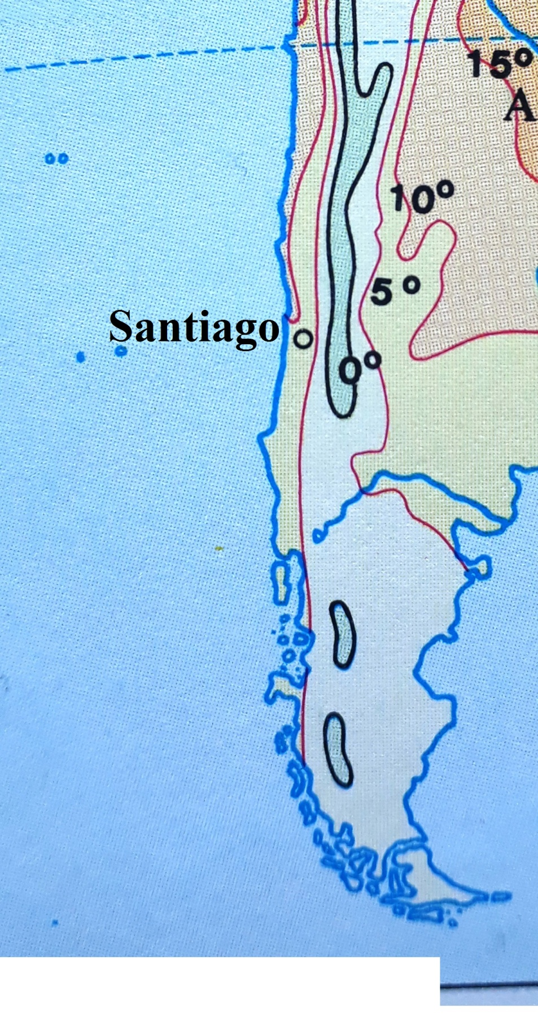
31) What factor influences the
spatial distribution of
isotherms in marked area
(red rectangular) during July?
A) DISTANCE FROM THE SEA
B) OCEAN CURRENTS
C) LATITUDE
D) TERRAIN (RELIEF)

Slide 33
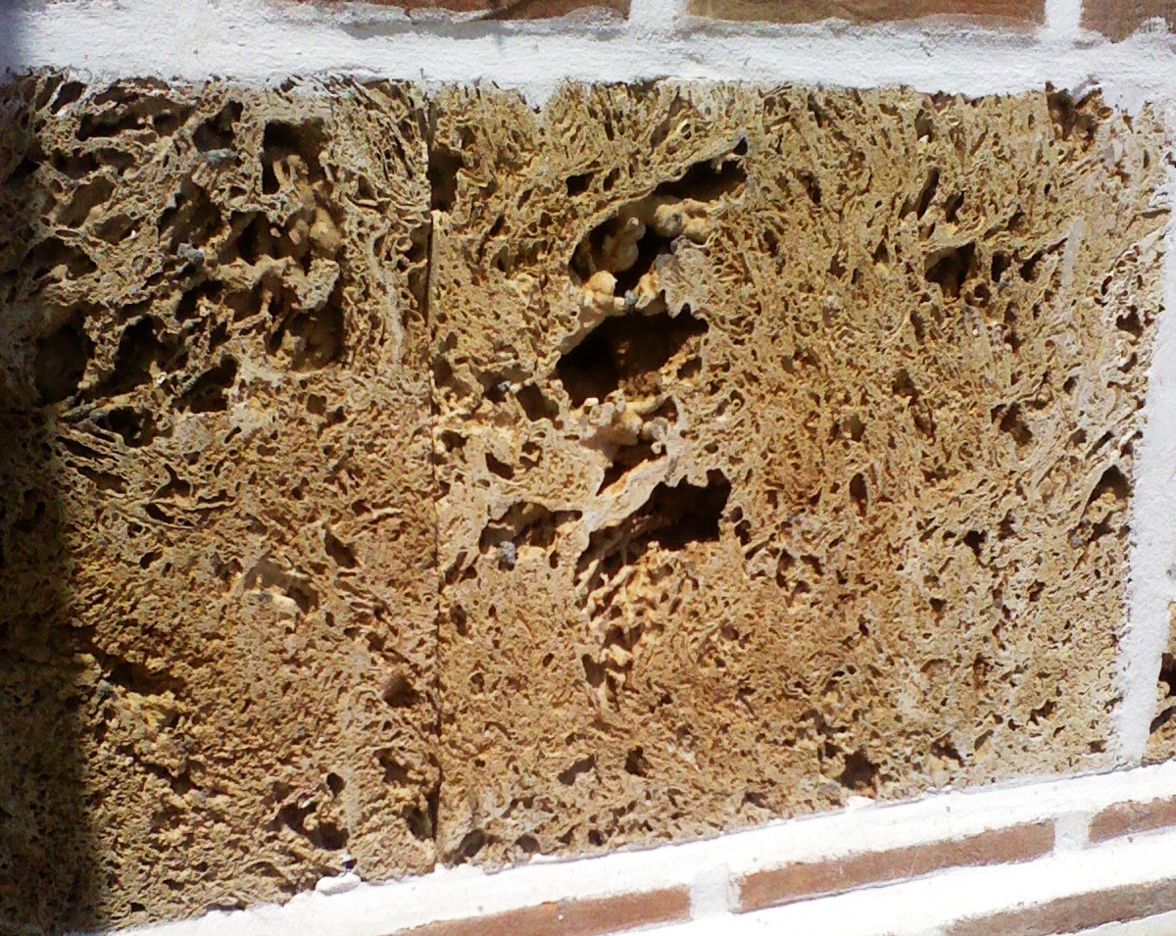
32) What is the name of rock from the picture that is used as a decorative building stone?
A) TUFA
B) LIMESTONE
C) MARBLE
D) SANDSTONE

Slide 34
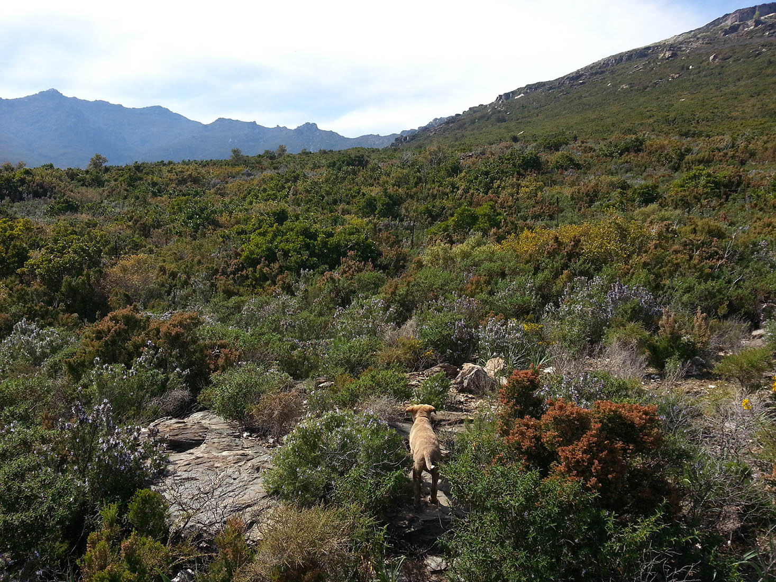
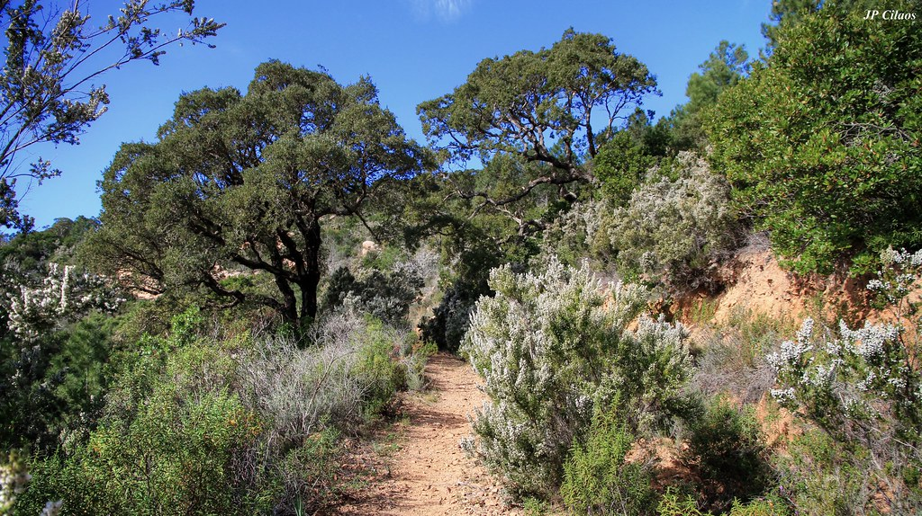
33) This type of vegetation is characteristic of:
A) CORSICA
B) BRITTANY
C) NORMANDY
D) PENNINE ALPS

Slide 35
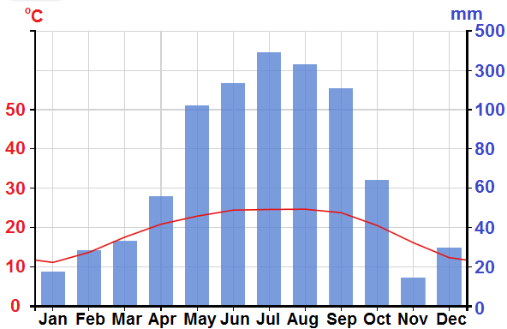
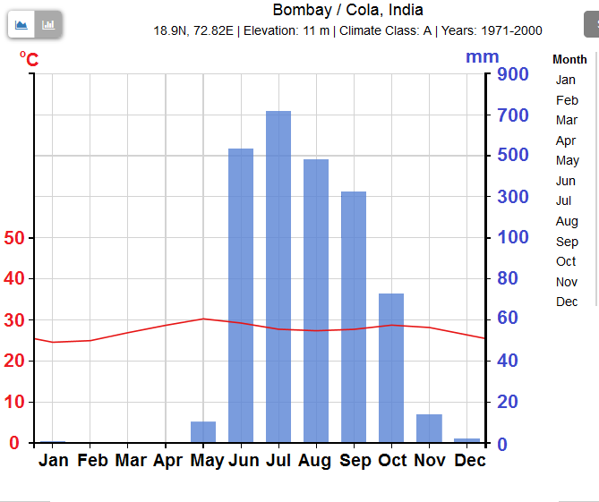
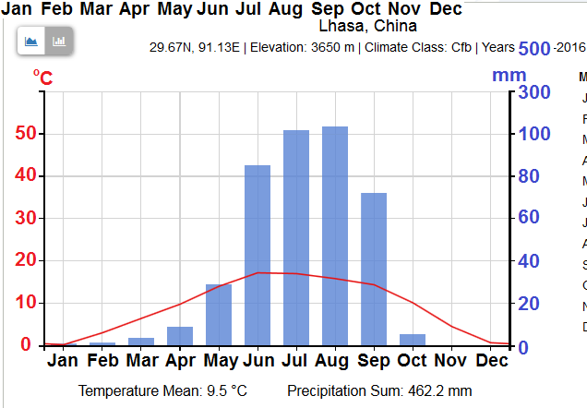
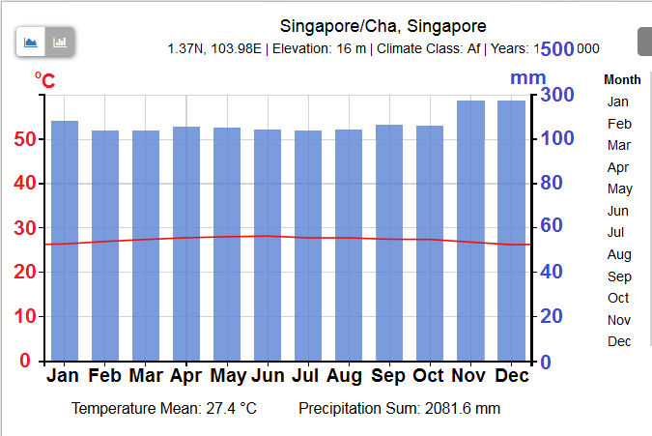
34) One of the following climate diagrams belongs to Lhasa (29˚ N, 91˚ E):
A
B
C
D

Slide 36
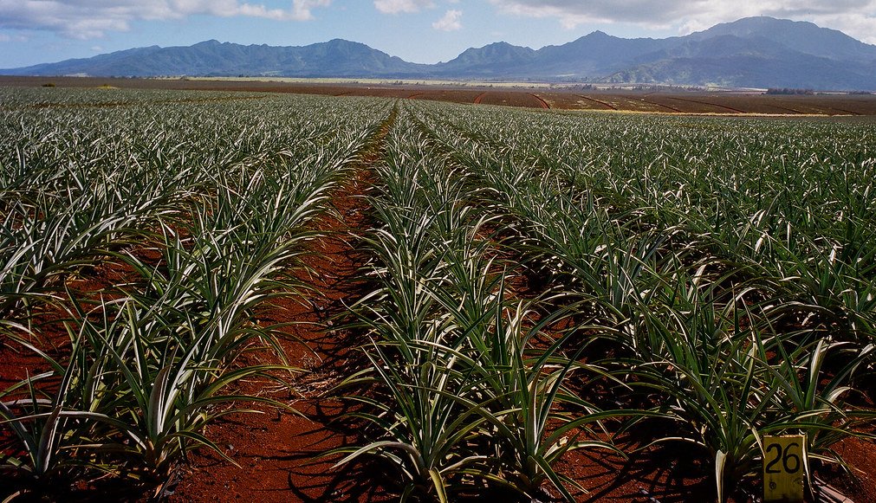
35) This picture shows a plantation of:
A) DATE PALMS B) PEANUTS
C) BANANAS D) PINEAPPLES

Slide 37
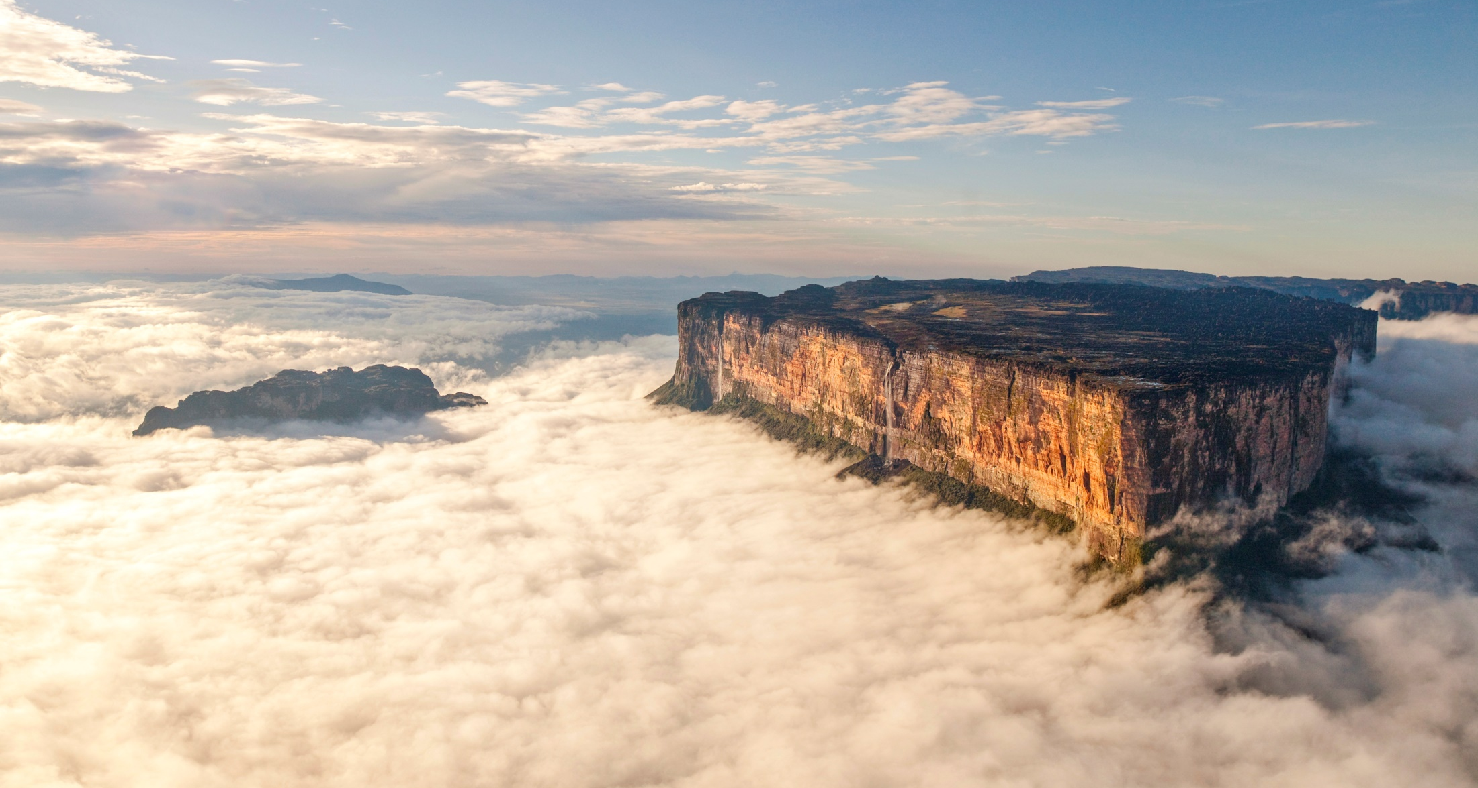
36) This mountain is a part of an old geological shield
of:
A) ASIA B)AFRICA
C) SOUTH AMERICA D) EUROPE

Slide 38
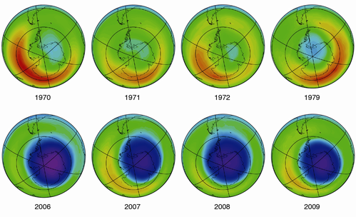
37) These maps shows one of the global phenomena:
A) CHANGING OF ANNUAL TEMPERATURE
B) OZONE HOLE
C) GLACIERS AND SEA ICE MELTING
D) AIR POLLUTION
1970 1971 1972 1979
2006 2007 2008 2009

Slide 39
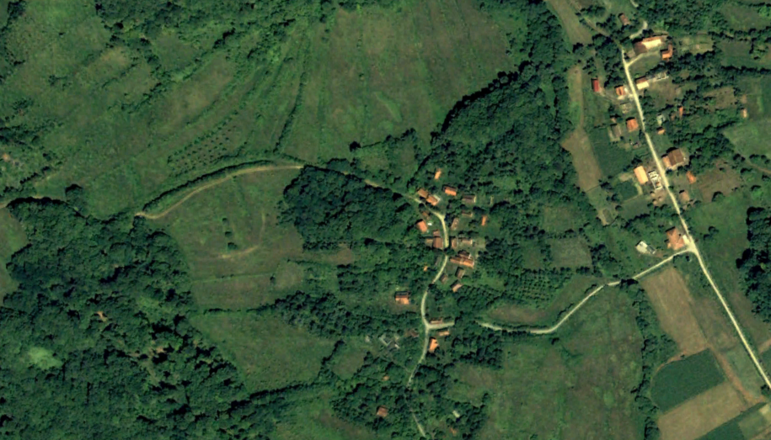


38) Changes in the landscape are caused by:
ABANDONMENT OF THE VILLAGES BY LOCALS
B) GLOBAL WARMING
C) AFFORESTATION
D) DESERTIFICATION
1998 2008 2018

Slide 40

39) This picture was taken from the lake:
A) MICHIGAN B) ONTARIO
C) MANITOBA D) WINNIPEG

Slide 41





40) Did you enjoy today’s Belgrade walking tour?
A
B
C
D

